Slide 1
Virtualization
Virtualization is a technique, which allows to share single physical instance of an application or resource among multiple organizations or tenants (customers). It does so by assigning a logical name to a physical resource and providing a pointer to that physical resource when demanded.

Slide 2
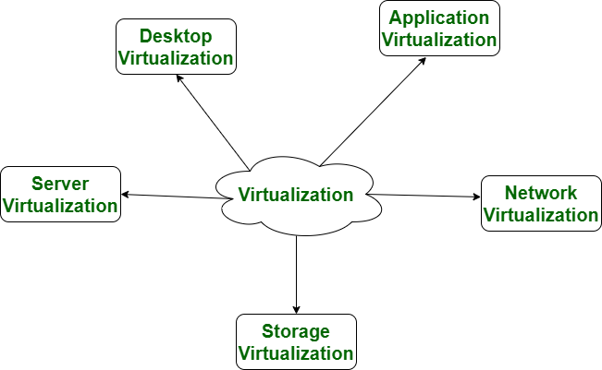
Virtualization

Slide 3
Trends in Computing
Distributed Computing
Grid Computing
Cluster Computing
Utility Computing
Cloud Computing

Slide 4
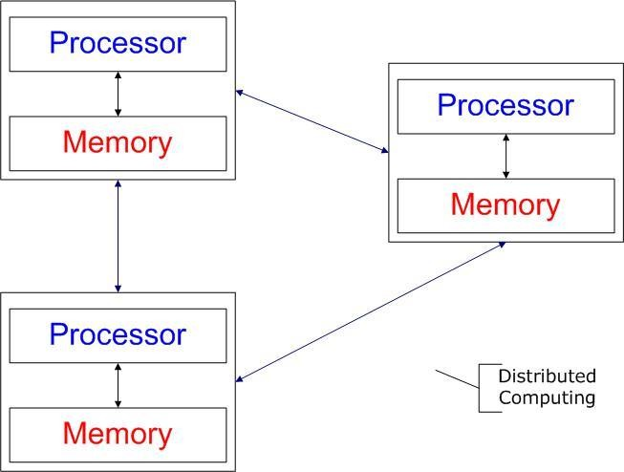
Distributed Computing/System?
Distributed computing
Field of computing science that studies distributed system.
Use of distributed systems to solve computational problems.
There are several autonomous computational entities, each of which has its own local memory.
The entities communicate with each other by message passing.
Examples
Internet
ATM (bank) machines
Intranets/Workgroups

Slide 5
Grid Computing
Grid Computing refers to distributed computing in which a group of computers from multiple locations are connected with each other to achieve common objective. These computer resources are heterogeneous and geographically dispersed. Grid Computing breaks complex task into smaller pieces. These smaller pieces are distributed to CPUs that reside within the grid.

Slide 6
Cluster Computing?
A cluster is a type of parallel or distributed computer system, which consists of a collection of inter-connected stand-alone computers working together as a single integrated computing resource .
Key components of a cluster include multiple standalone computers (PCs, Workstations, or SMPs), operating systems, high-performance interconnects, middleware, parallel programming environments, and applications.
Clusters are usually deployed to improve speed and/or reliability over that provided by a single computer, while typically being much more cost effective than single computer the of comparable speed or reliability
Types:
High Availability or Failover Clusters
Load Balancing Cluster
Parallel/Distributed Processing Clusters

Slide 7
“Utility” Computing ?
Utility Computing is purely a concept which cloud computing practically implements.
Utility computing is a service provisioning model in which a service provider makes computing resources and infrastructure management available to the customer as needed, and charges them for specific usage rather than a flat rate.
This model has the advantage of a low or no initial cost to acquire computer resources; instead, computational resources are essentially rented.
The word utility is used to make an analogy to other services, such as electrical power, that seek to meet fluctuating customer needs, and charge for the resources based on usage rather than on a flat-rate basis. This approach, sometimes known as pay-per-use

Slide 8
Cloud Computing
What is Cloud?
The term Cloud refers to a Network or Internet. In other words, we can say that Cloud is something, which is present at remote location. Cloud can provide services over network, i.e., on public networks or on private networks, i.e., WAN, LAN or VPN. Applications such as e-mail, web conferencing, customer relationship management (CRM),all run in cloud.
What is Computing?
"In a general way, we can define computing to mean any goal-oriented activity requiring, benefiting from, or creating computers. Thus, computing includes designing and building hardware and software systems for a wide range of purposes; processing, structuring, and managing various kinds of information; doing scientific studies using computers; making computer systems behave intelligently; creating and using communications and entertainment media; finding and gathering information relevant to any particular purpose, and so on. The list is virtually endless, and the possibilities are vast."

Slide 9
Cloud Computing
Cloud computing is a model for enabling universal, convenient, on-demand network access to a shared pool of configurable computing resources (e.g networks, servers, storage, applications, and services) that can be rapidly provisioned and released with minimal management effort or service provider interaction.

Slide 10
Cloud Computing-Architecture
FRONT END
Front End refers to the client part of cloud computing system. It consists of interfaces and applications that are required to access the cloud computing platforms, e.g., Web Browser.
BACK END
Back End refers to the cloud itself. It consists of all the resources required to provide cloud computing services. It comprises of huge data storage, virtual machines, security mechanism, services, deployment models, servers, etc.

Slide 11
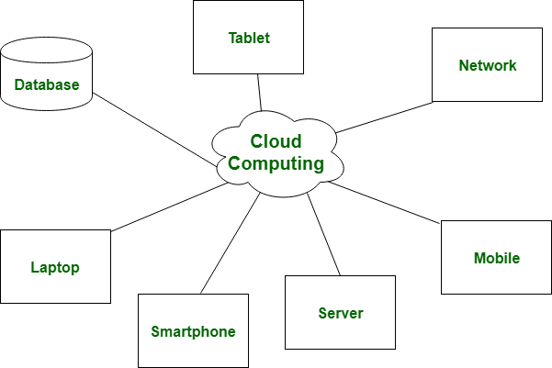
Cloud Computing-Architecture

Slide 12
Common Characteristics
On-demand self-services
Broad network access
Rapid elasticity
Multi-tenancy
Measured service
Virtualization
Resilient computing
Flexible pricing models
Security
Automation

Slide 13
Advantages of Cloud Computing
Lower computer costs:
No need of a high-powered and high-priced computer to run cloud computing's web-based applications.
Since applications run in the cloud, not on the desktop PC, your desktop PC does not need the processing power or hard disk space demanded by traditional desktop software.
When you are using web-based applications, your PC can be less expensive, with a
smaller hard disk, less memory, more efficient processor...
In fact, your PC in this scenario does not even need a CD or DVD drive, as no software programs have to be loaded and no document files need to be saved.

Slide 14
Advantages of Cloud Computing
Improved performance:
With few large programs hogging your computer's memory, you will see better performance from your PC.
Computers in a cloud computing system boot and run faster because they have fewer programs and processes loaded into memory.
Reduced software costs:
Instead of purchasing expensive software applications, you can get most of what you need for free.
most cloud computing applications today, such as the Google Docs suite.
better than paying for similar commercial software
which alone may be justification for switching to cloud applications.

Slide 15
Advantages of Cloud Computing
Instant software updates
Another advantage to cloud computing is that you are no longer faced with choosing between obsolete software and high upgrade costs.
When the application is web-based, updates happen automatically available the next time you log into the cloud.
When you access a web-based application, you get the latest version without needing to pay for or download an upgrade.
Improved document format compatibility.
You do not have to worry about the documents you create on your machine being compatible with other users' applications or OS.
There are less format incompatibilities when everyone is sharing documents and applications in the cloud.

Slide 16
Advantages of Cloud Computing
Unlimited storage capacity
Cloud computing offers virtually limitless storage.
Your computer's current 1 Tera Bytes hard drive is small compared to the hundreds of Peta Bytes available in the cloud.
Increased data reliability
Unlike desktop computing, in which if a hard disk crashes and destroy all your valuable data, a computer crashing in the cloud should not affect the storage of your data.
if your personal computer crashes, all your data is still out there in the cloud, still accessible
In a world where few individual desktop PC users back up their data on a regular basis, cloud computing is a data-safe computing platform. For e.g. Dropbox, Skydrive

Slide 17
Advantages of Cloud Computing
Universal information access
That is not a problem with cloud computing, because you do not take your documents with you.
Instead, they stay in the cloud, and you can access them whenever you have a computer and an Internet connection
Documents are instantly available from wherever you are.
Device independence
You are no longer tethered to a single computer or network.
Changes to computers, applications and documents follow you through the cloud.
Move to a portable device, and your applications and documents are still available.

Slide 18
Disadvantages of Cloud Computing
Requires a constant internet connection
Cloud computing is impossible if you cannot connect to the Internet.
Since you use the Internet to connect to both your applications and documents, if you do not have an Internet connection you cannot access anything, even your own documents.
A dead Internet connection means no work and in areas where Internet connections are few or inherently unreliable, this could be a deal-breaker.
Does not work well with low-speed connections
Similarly, a low-speed Internet connection, such as that found with dial-up services, makes cloud computing painful at best and often impossible.
Web-based applications require a lot of bandwidth to download, as do large documents.

Slide 19
Disadvantages of Cloud Computing
Features might be limited
This situation is bound to change, but today many web-based applications simply are not as full-featured as their desktop-based applications.
For example, you can do a lot more with Microsoft PowerPoint than with Google Presentation's web-based offering
Can be slow
Even with a fast connection, web-based applications can sometimes be slower than accessing a similar software program on your desktop PC.
Everything about the program, from the interface to the current document, has to
be sent back and forth from your computer to the computers in the cloud.
If the cloud servers happen to be backed up at that moment, or if the Internet is having a slow day, you would not get the instantaneous access you might expect from desktop applications.

Slide 20
Disadvantages of Cloud Computing
Stored data might not be secured
With cloud computing, all your data is stored on the cloud.
The questions is How secure is the cloud?
Can unauthorized users gain access to your confidential data ?
Stored data can be lost!
Theoretically, data stored in the cloud is safe, replicated across multiple machines.
But on the off chance that your data goes missing, you have no physical or local backup.
Put simply, relying on the cloud puts you at risk if the cloud lets you down.

Slide 21
Types of clouds
(Deployment Models)

Slide 22
Types of Clouds
Clouds can be classified in terms of who owns and manages the cloud
Public Clouds
Private Clouds
Hybrid Clouds
Community Clouds

Slide 23
Public Cloud
A public cloud or external cloud
are available to the general public in a pay-as-you-go manner
Customers, individual users or enterprises
access these services over the internet from a third-party provider who may share computing resources with many customers
Security and data governance are the main concern with this approach

Slide 24
Public Cloud

Slide 25
Public Cloud
Benefits
COST EFFECTIVE
Since public cloud share same resources with large number of consumer, it has low cost.
RELIABILITY
Since public cloud employs large number of resources from different locations, if any of the resource fail, public cloud can employ another one.
FLEXIBILITY
It is also very easy to integrate public cloud with private cloud, hence gives consumers a flexible approach.
LOCATION INDEPENDENCE
Since, public cloud services are delivered through Internet, therefore ensures location independence.
UTILITY STYLE COSTING
Public cloud is also based on pay-per-use model and resources are accessible whenever consumer needs it.
HIGH SCALABILITY
Cloud resources are made available
Disadvantages
LOW SECURITY
In public cloud model, data is hosted off-site and resources are shared publicly, therefore does not ensure higher level of security.
LESS CUSTOMIZABLE
It is comparatively less customizable than private cloud.

Slide 26
Private Cloud
Private Clouds uses the same base technologies as Public Clouds, but provides more customization to the infrastructure such as specific value-added hardware or software components because Private Clouds run behind the firewall and located at the Client site or outsourced Service Providers site.
A Private Cloud or Internal cloud
is used when the cloud infrastructure, proprietary network or data center, is operated solely for a business or organization, and serves customers within the business fire-wall

Slide 27
Private Cloud
Most of the private clouds are large company or government departments who prefer to keep their data in a more controlled and secure environment

Slide 28
Hybrid Cloud
A composition of the two types (private and public) is called a Hybrid Cloud
Where a private cloud is able to maintain high services availability by scaling up their system with externally provisioned resources from a public cloud when there are rapid workload fluctuations or hardware failures
In the Hybrid cloud, an enterprise can keep their critical data and applications within their firewall, while hosting the less critical ones on a public cloud

Slide 29
Hybrid Cloud

Slide 30
Community Cloud
In a community cloud, several enterprises with similar requirements can share their infrastructures, thus increasing their scale while sharing the cost
Another form of community cloud may be established by creating a virtual data center from virtual machines instances deployed on underutilized users machines

Slide 31
Community Cloud

Slide 32
Types of cloud services

Slide 33
Types of Cloud Services
A Cloud is essentially a class of systems that deliver IT resources to remote users as a service
The resources encompass hardware, programming environments and applications
The cloud computing services are falls into three basic types
Infrastructure as a service (IaaS)
- Bare mental service on demand
Platform as a Service (PaaS)
- Applications and APIs
Software as a service (SaaS)
- Internet based development services

Slide 34
Infrastructure as a service (IaaS)
The IaaS also offers:
• Virtual machine disk storage
• Virtual local area network (VLANs)
• Load balancers
• IP addresses
Characteristics:
• Virtual machines with pre-installed software.
• Virtual machines with pre-installed Operating Systems such as Windows, Linux, and Solaris.
• On-demand availability of resources.
• Allows to store copies of particular data in different locations.
• The computing resources can be easily scaled up and down.

Slide 35
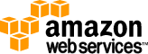

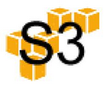
Popular IaaS Systems
Amazon Elastic Compute Cloud (EC2)
EC2 provides many useful features for customers, including a mature and inexpensive billing system able to charge for computing at a very fine-grained level (memory usage, CPU usage, data transfer, etc.)
GoGrid
Both EC2 and GoGrid provide basic and common features of cloud computing. The difference between the services they provide mainly derives from their respective business models. For example, GoGrid provides free cloud and persistent storage, slightly different from Amazon
Amazon Simple Storage Service
The Amazon Simple Storage Service (2010) (S3) is an online storage web service offered by Amazon Web Services.

Slide 36
Platform as a Service (PaaS)
• PaaS provides built-in security, scalability, and web service interfaces.
• PaaS provides built-in tools for defining workflow and approval processes and defining business rules.
• It is easy to integrate with other applications on the same platform.
• PaaS also provides web services interfaces that allow us to connect the applications outside the platform.

Slide 37
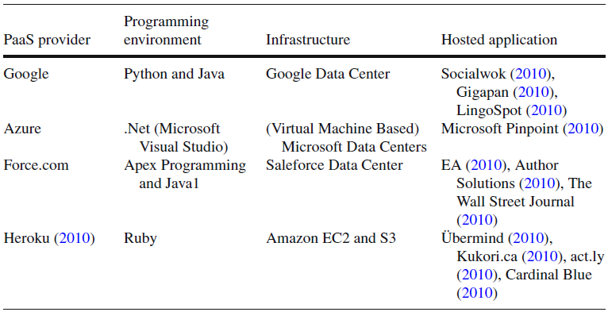
Three Typical PaaS

Slide 38
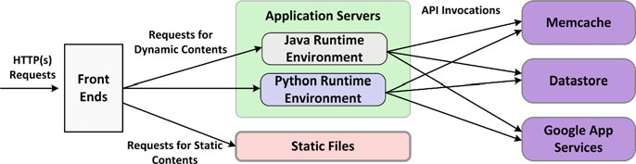
Google App Engine
Google App Engine (GAE)’s main goal is to efficiently run users’ web applications
As shown in following figure, it maintains Python and Java runtime environments on application servers, along with some simple APIs to access Google services
The Architecture of Google App Engine

Slide 39
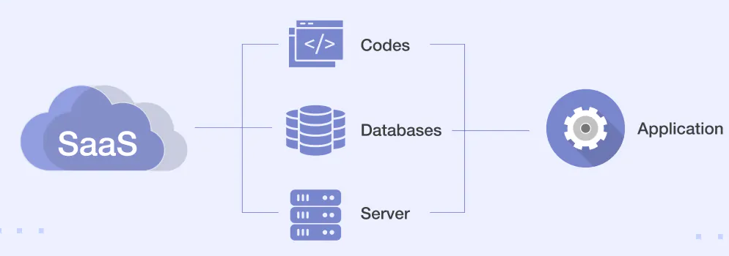
Software as a service (SaaS)
Characteristics
Here are the characteristics of SaaS service model:
• SaaS makes the software available over the Internet.
• The Software are maintained by the vendor rather than where they are running.
• The license to the software may be subscription based or usage based. And it is billed on recurring basis.
• SaaS applications are cost effective since they do not require any maintenance at end user side.
• They are available on demand.
• They can be scaled up or down on demand.
• They are automatically upgraded and updated.
• All users are running same version of the software.

Slide 40
SaaS Examples
Desktop as a Service
provides a virtualized desktop-like personal workspace, and sends its image to the user’s real desktop
Access desktop-on-thecloud from different places for convenience, and receive the benefit of SaaS at same time
Google Apps
Mail, talk, calendar, docs, websites
Salesforce
a business SaaS cloud platform
provides customizable applications, mostly Customer Relationship Management (CRM) services

Slide 41
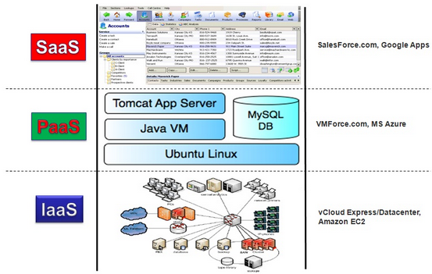
SPI Model in Cloud Computing

Slide 42
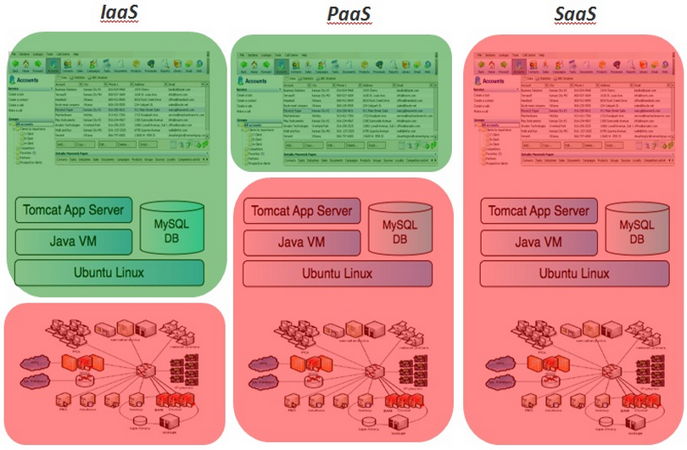
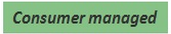
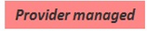
SPI Model in Cloud Computing

Slide 43
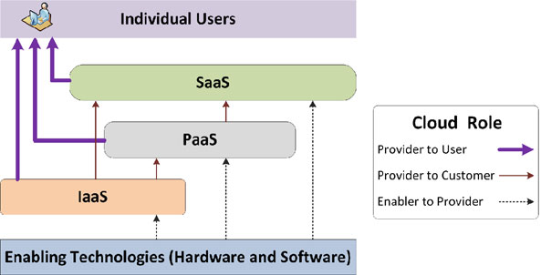
Cloud Services and Cloud Roles
Different enterprises play different roles in building and using cloud systems
Technology Enablers
Enabling the underlying technologies used to build the cloud, such as hardware technologies, Virtualization technology, web services
Cloud Providers
Cloud Customers
Users
Delivering their
infrastructure and
platform to customers
Using the providers’ services to improve their web applications
Who use the web applications

Slide 44
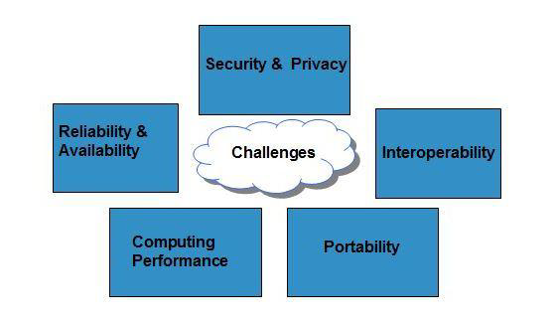
Cloud Computing Challenges
Notes:
SECURITY & PRIVACY
Security and Privacy of information is the biggest challenge to cloud computing. Security and privacy issues can be overcome by employing encryption, security hardware and security applications.
PORTABILITY
This is another challenge to cloud computing that applications should easily be migrated from one cloud provider to another. There should not be vendor lock-in. However, it is not yet made possible because each of the cloud provider uses different standard languages for their platforms.
INTEROPERABILITY
Application on one platform should be able to incorporate services from other platform. It is made possible via web services. But writing such web services is very complex.
COMPUTING PERFORMANCE
To deliver data intensive applications on cloud requires high network bandwidth, which results in high cost. If done at low bandwidth, then it does not meet the required computing performance of cloud application.
RELIABILITY AND AVAILABILITY
It is necessary for cloud systems to be reliable and robust because most of the businesses are now becoming dependent on services provided by third-party.

Slide 45
Mobile Cloud Computing
Smartphones require less processing, less power.
Processing is done in cloud, data is stored in cloud. And the mobile devices serve as a media for display.
Smartphones are employed with rich cloud services by integrating applications that consume web services. These web services are deployed in cloud.
There are several Smartphone operating systems available such as Google's Android, Apple's iOS, RIM BlackBerry, Symbian, and Windows Mobile Phone. Each of these platforms support third-party applications that are deployed in cloud.

